Slide 2


Slide 3



Problem
Normal Force
Gravity

Slide 5
Basic Knowledge
Newton's laws of motion

Slide 6
Basic Knowledge
First Law: Law of Inertia

Slide 7
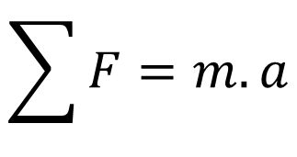
Basic Knowledge
Second Law: Law of Dynamics
$$\sum{F}=m.a$$
F

Slide 8
Basic Knowledge
Third Law: Action and Reaction

Slide 9
Basic Knowledge
Third Law: Action and Reaction
F’
F

Slide 10
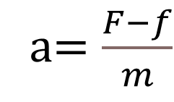
Force analysis
F
a$=\frac{F−f}{m}$
F
f
Weight: m
f
Weight: m

Slide 11
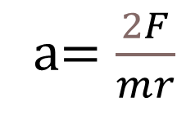
Force analysis
F
r
a$=\frac{2F}{mr}$
f
Weight: m

Slide 13
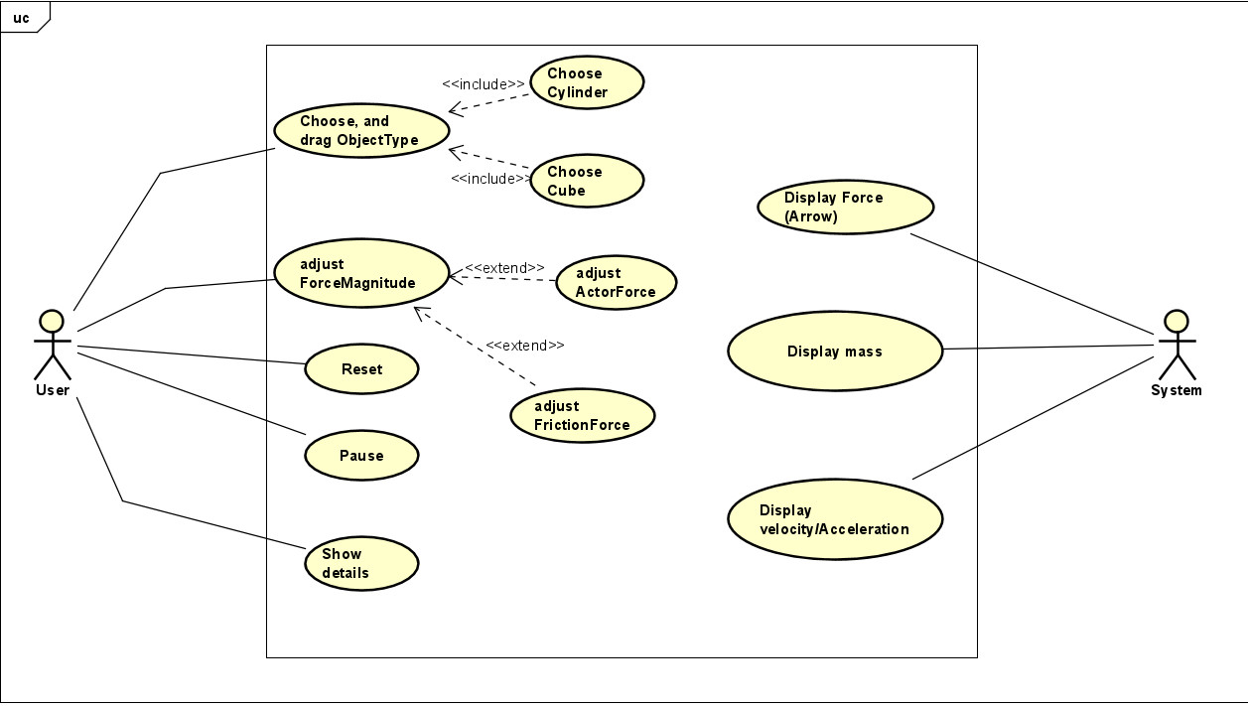
UseCase Diagram

Slide 14
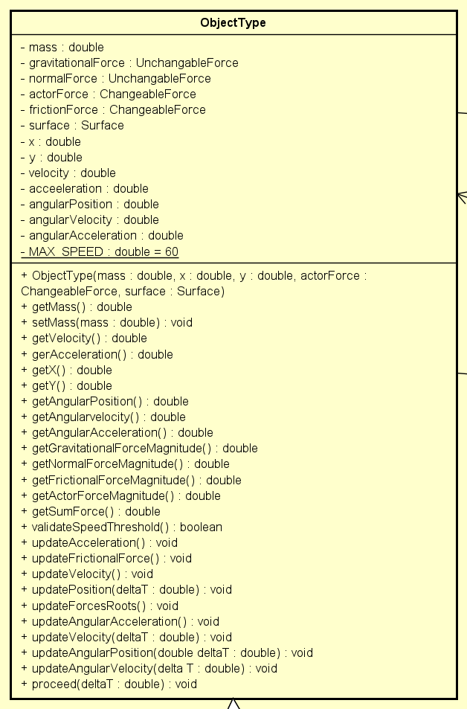
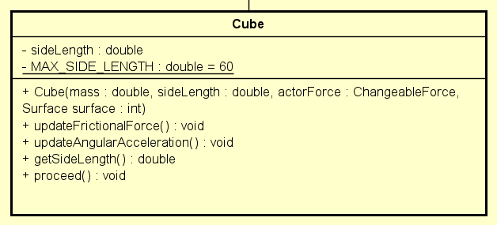
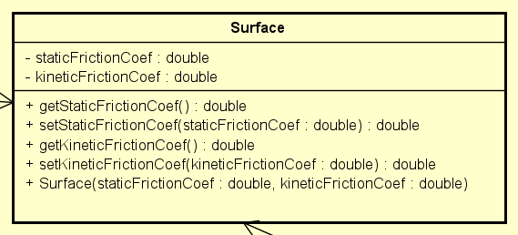
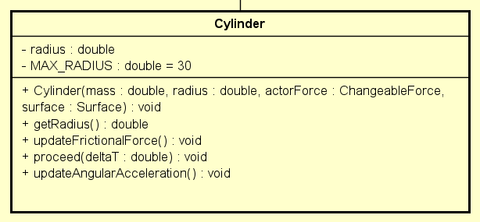
Object

Slide 15
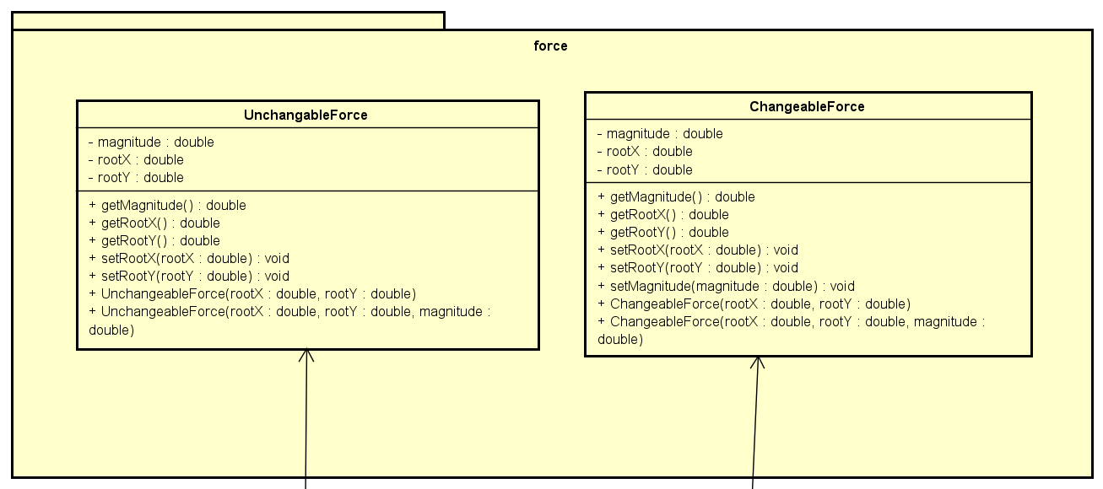
Force

Slide 16
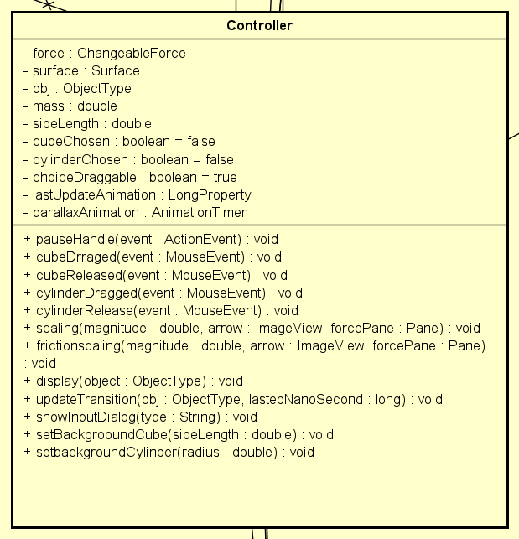
Controller

Slide 17
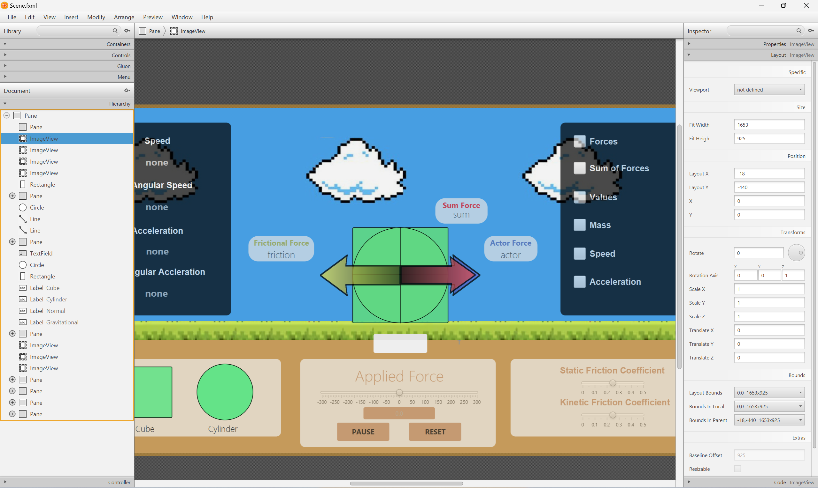
Controller

Slide 18
1
2
4
3
Techniques
Encapsulation
Abstraction
Inheritance
Polymorphism

Slide 19
1
2
3
4
Encapsulation
Inheritance
Polymorphism
Abstraction

Slide 20
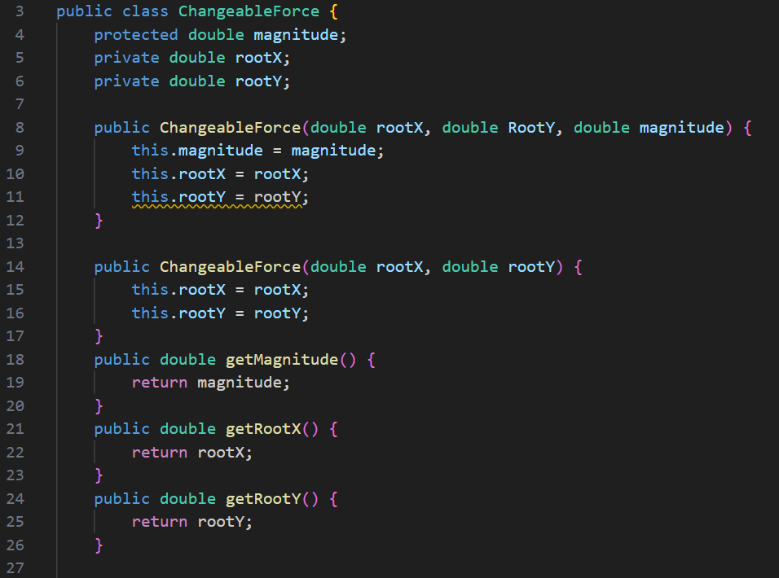
1
2
3
4
Encapsulation
Inheritance
Polymorphism
Abstraction

Slide 21
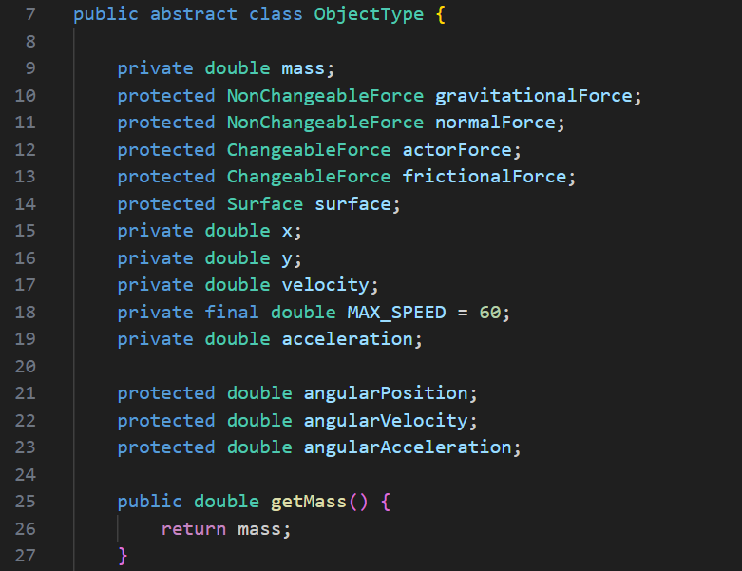
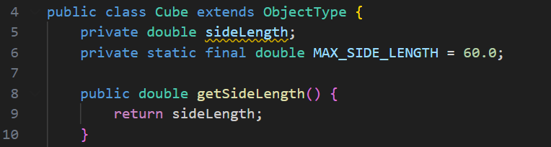
2
Inheritance

Slide 22
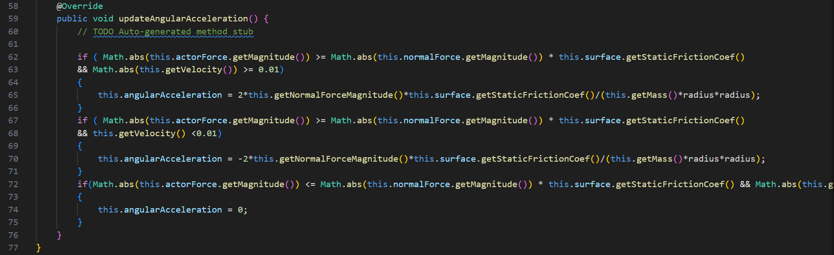
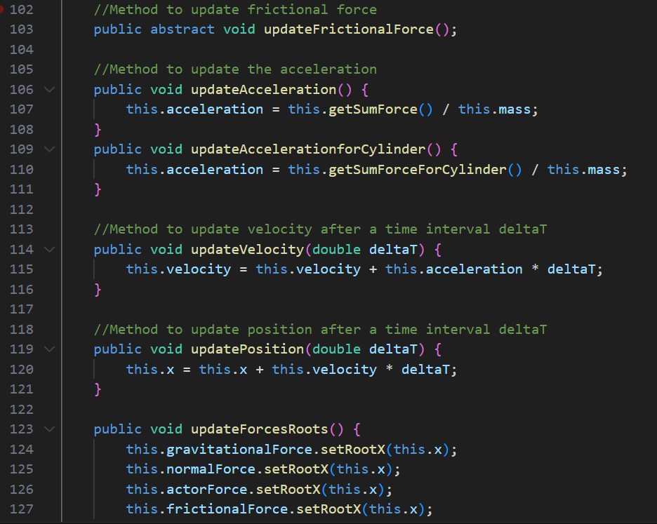
3
Polymorphism

Slide 23
4
Abstraction

